Slide 1
FEMALE CAREER DEVELOPMENT AND EMPOWERMENT
Topic 3

Slide 2
THINK-MANAGER,
THINK-MALE
Unconscious bias and stereotypes
Implicit leadership theories
Role congruity theory
Leadership as a male paradigm?

Slide 3
UNCONSCIOUS
BIAS & STEREOTYPES

Slide 4
Humans are simply fallible to UNCONSCIOUS BIAS. We don’t mean to be biased, we don’t want to be biased. But we are. And we don’t get past it by pointing it out to one another.
Kerry Edelstein

Slide 5
The emotional, sexual and psychological stereotyping of females begins when the doctor says, ‘It’s a girl’.
Shirley Chisholm
STEREOTYPES are mental shortcuts that we take to make sense of a complicated world.
Timothy D. Wilson

Slide 6
GROUP DISCUSSION Impact of stereotypes
Where do you encounter stereotypes?
How do stereotypes affect female leaders?
What do you do in your counselling to support women who self-stereotype?

Slide 7
Effects of gender stereotyping
Book recommendation:
Invisible Women by Caroline Criado Perez
Expectations from an early age
Self-stereotyping
Development of skills
Career development
Stereotyped roles (e.g., caretaking tasks, raising children)
Disparities in health, education, wages, financial independence
Notes:
Invisable women by Caroline Criado Perez
Nice Girls Don’t Get the Corner Office by Lois P. Frankel

Slide 8
IMPLICIT LEADERSHIP THEORIES

Slide 9
Implicit leadership theories are subconscious beliefs, assumptions, and mental frameworks that individuals hold about the traits, behaviours, and characteristics associated with effective leaders; they influence how individuals perceive and react to leaders.

Slide 10
Implicit leadership theories
Koenig et al. (2011)
THE RESEARCH PARADIGMS
How stereotypically male are leaders/leadership positions perceived?
THINK MANAGER – THINK MALE | AGENCY – COMMUNION | MASCULINITY – FEMININITY
Meta-Analysis by Koenig et al. (2011)

Slide 11
Think Manager – Think Male
Koenig et al. (2011)
All experimental groups receive the same list of attributes (e.g., Revised Descriptive Index), which are to be evaluated in relation to a certain group of persons.
women/men/leaders are:
Hard-working
□
□
□
□
□
□
Not applicable
Applicable
Group 1 | Group 2 | Group 3
Women | Ideal leader | Men
Average Value
Average Value
Average Value
Women-leader-correlation
Men-leader-correlation
Stereotypically male leadership understanding if Men-leader-correlation > Women-leader-correlation

Slide 12
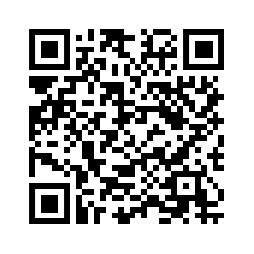
Agency-communion Bem Sex-Role-Inventory (BSRI)
Imagine your ideal leader!
https://www.psytoolkit.org/cgi-bin/3.4.4/survey?s=BsNnQ

Slide 13
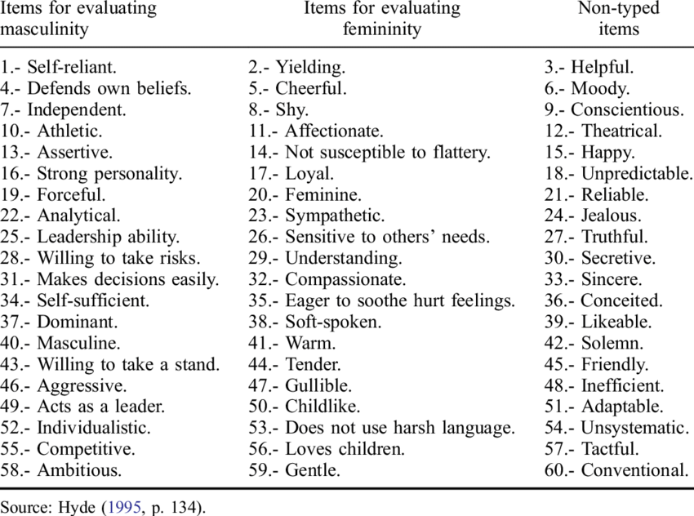
Agency-communion
Koenig et al. (2011); Ferrer-Pérez & Bosch-Fiol (2014)
.
All participants receive the same list of connotative characteristics (e.g., Bem Sex-Role Inventory), which are to be evaluated in relation to leaders.
Leaders are:
Not Applicable
Applicable
Forceful (a)
□
□
□
□
□
□
Shy (c)
□
□
□
□
□
□
Stereotypically male leadership understanding if male (agentic) attributes > female (communal) attributes

Slide 14
Masculinity-femininity
Koenig et al. (2011)
All participants receive the same list of professions (e.g., classification of professions), which are to be evaluated in terms of masculinity/femininity.
Professions are:
masculine
feminine
politicians
□
□
□
□
□
□
chefs
□
□
□
□
□
□
Stereotypically male leadership/profession understanding if masculine > feminine

Slide 15
Findings
Koenig et al. (2011)
Time of publication
Over time, the understanding of leadership has become more feminine; female competencies are increasingly associated with leadership positions.
Gender of participants
Men are more likely to associate leadership with masculine connotated competencies than women.
Hierarchical level of leadership position
Leadership competencies with a masculine connotation tend to be associated with managers at higher levels.

Slide 16
ROLE CONGRUITY
THEORY

Slide 17
Role congruity is the extent to which an individual’s perception (implicit gender theory) matches the preconceived expectations (implicit leadership theories) held towards a role (leading position).

Slide 18
Role Congruity Theory
Mai, Büttgen & Scharzinger (2016)
Implicit Leadership Theory
How should a leader be?
Implicit Gender Theory
How should a man/woman be?
Think Manager-Think Male
Think Woman-Think Female
Role (In-)Congruity
Female attributes ≠ leadership understanding → misfit
Male attributes ≠ female understanding → non-authentic → misfit
BACKLASH EFFECT

Slide 19
Perception of applicant fit
Dutz, Hubner & Peus (2021)
HR describes the leader they look for
HR meets applicants for job interviews
(Biased) job advertisement
→ Think Manager – Think Male
→ Third-party-ascribed role incongruity
→ Third-party-exclusion of female applicants
Self-ascribed role incongruity
Self-exclusion of female applicants

Slide 20
Female-specific challenges
Role models
EFFECTS ON FEMALE CAREERS
Chosen aspects of workplace interaction

Slide 21
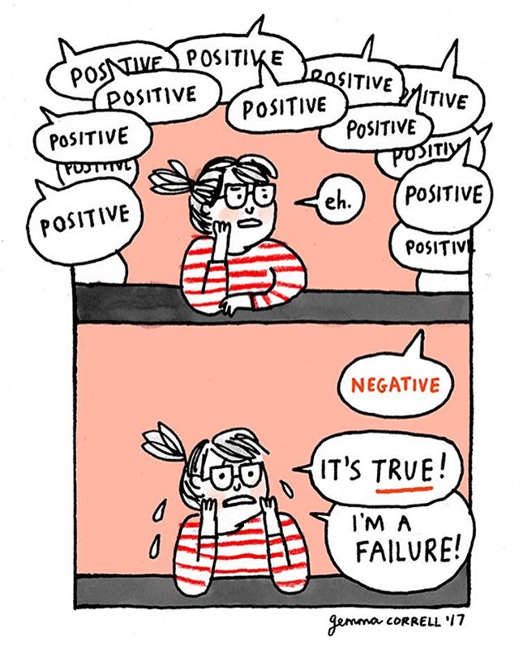

Slide 22
FEMALE- SPECIFIC
CHALLENGES

Slide 23
Imposter Syndrome
You think, “Why would anyone want to see me again in a movie? And I don’t know how to act anyway, so why am I doing this?”
Meryl Streep, 21 Oscar nominations, 3 Oscars

Slide 24
Queen Bee Syndrome
Queen bee syndrome describes a woman of authority who views or treats subordinates more critically if they are female
First defined by G.L. Staines, T.E. Jayaratne and C. Tavris in 1973

Slide 25
Crab Basket Syndrome
When there is one crab in a basket, it can easily climb out. However, as soon as there are multiple crabs in the basket and one of them wants to escape, the others pull the climbing crab back down. Women do this to each other as well, by unnecessarily judging one another and keeping each other small in that way.

Slide 26
Professional Challenges
Potential self- and third-party-stereotyping might be about:
Gender roles and belongings
Abilities; e.g. technical/digital, interpersonal, etc.

Slide 27
Private Challenges
Potential private challenges addressed by a female might be:
Physical challenges (e.g. menstruation, pregnancy, menopause)
Care taking responsibilities
Other individual challenges she might consider hindering her leadership ability

Slide 28
ROLE
MODELS

Slide 29
GROUP DISCUSSION Importance of role models
What is a role model in terms of female leadership?
Why are role models needed?
How to activate/create role models as a guidance professional?

Slide 30
„Each generation expanded its horizons, learning from the successes and failures of the preceding generation and leaving lessons for the next wave of women.”
C. Goldin (2023)

Slide 31
Effect of role models
Role models represent and expand what is possible
Role models inspire women to be more ambitious and aim higher
Role models demonstrate the mindsets and behaviours of how to rise
Role models go along with female mentorship
Activate role models?
Express the necessity; emphasise the effect
Address the imposter syndrome
Spread it throughout hierarchy

Slide 33
References
Carli, L. L., Alawa, L., Lee, Y. A., Zhao, B., Kim, E. (2016). Stereotypes about gender and science: women # scientists. Psychology of Women Quarterly 40 (2), 244-260.
Dutz, R., Hubner, S., Peus, C. (2021). When agency „fits“ regardless of gender: Perceptions of applicant fit when job and organization signal male stereotypes. Personnel Psychology 2022 (75), 441-483.
Ellemers, N. (2018). Gender stereotypes. Annual Review of Psychology 69, 275-298.
Goldin, C. (2021), Career & family. Women's century-long journey toward equity, Princeton, Oxford: Princeton University Press.
Koenig, A. M., Eagly, A. H., Mitchell, A. A., Ristikari, T. (2011). Are leader stereotypes masculine? A meta-analysis of three research paradigms. Psychological Bulletin 137 (4), 616-642.
Mai, C., Büttgen, M., Scharzinger, D. (2016). “Think-Manager-Consider-Female”: Eine Analyse stereotypischer Ansichten über weibliche Führungskräfte und die empirische Überprüfung ihrer realen Persönlichkeit anhand der Big Five und der Dunklen Triade. Schmalenbachs Z betriebswirtsch Forsch 2017 (69), 119-152.
Ferrer-Pérez, V., Bosch-Fiol, E. (2014). The measure of the masculinity–femininity construct today: Some reflections on the case of the Bem Sex Role Inventory. Revista de Psicología Social. 29. 180-207.
Staines, G., Tavris, C., Jayaratne, Toby E. (1974). The Queen Bee syndrome. Psychology Today, 7, 55-60.
Stadelmaier, V. (2016). Sure She Can: Crush this insecurity, 7th edition, SheMedia.

