Slide 1
PROFESSIONAL COUNSELLING
Topic 5

Slide 2
Counselling as science
Problem-based learning with case studies
Perspective of a columnist
CREATING PROFESSIONAL COUNSELLING

Slide 3
COUNSELLING AS SCIENCE

Slide 4
"Anyone who believes that there can be one theory of guidance or 'the' theory of guidance is mistaken. In principle, there can be as many theories as there are phenomena that are relevant to guidance ..."
Hofer (2015)

Slide 5
Personality Dimensions
Localisation
Prestige
Status
Cognition
Sense
Cognition
Contribution to socially necessary production
Motivation for action and moral self-claim
PERSONAL EMPLOYABILITY
DIMENSIONS
Standards
Error concepts
Ideal
Cognition
Relevance
Cognition
Necessary for subsistence
Socially significance
Qualifications
Readiness
Competence
Cognition
Time
Cognition
Time budget
Biographical duration

Slide 6
All job-related personality dimensions of female managers must be considered. Even if individual aspects of the job - e.g., IT competence - are in focus, the interdependencies with the overall personality must always be included.
Beck (2019)

Slide 7
PROBLEM-BASED LEARNING

Slide 8
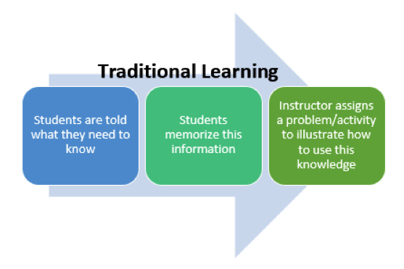
Traditional Learning

Slide 9
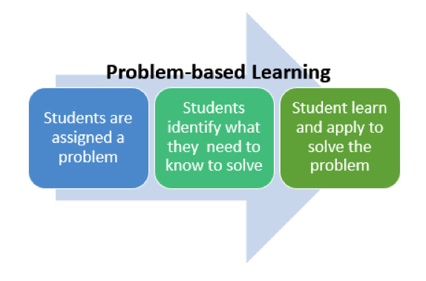
Problem-based learning

Slide 10
PBL learning outcomes
Nilson (2010)
Working in teams.
Managing projects and holding leadership roles.
Oral and written communication.
Self-awareness and evaluation of group processes.
Working independently.
Critical thinking and analysis.
Explaining concepts.
Self-directed learning.
Applying course content to real-world examples.
Researching and information literacy.
Problem-solving across disciplines.

Slide 11
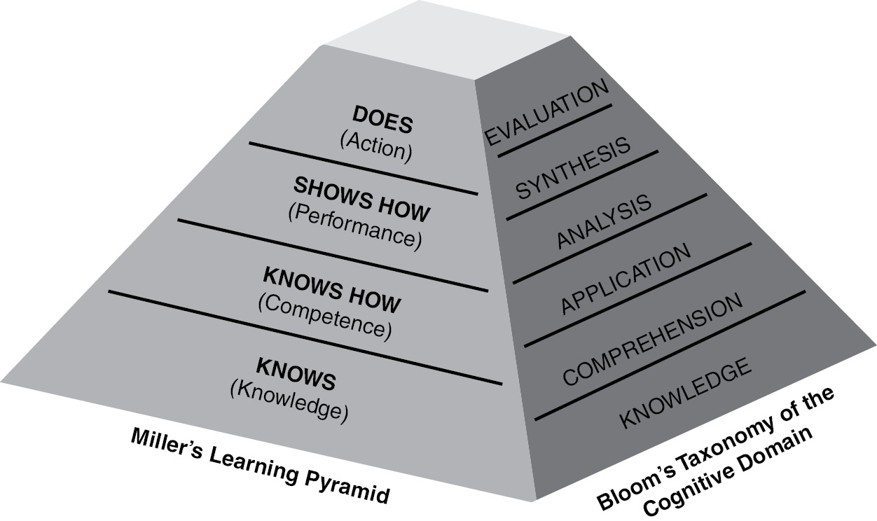
PBL Taxonomies (Bloom & Miller)
Nilson (2010)

Slide 12
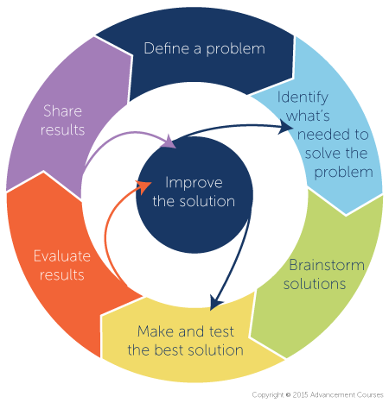
7 stages in PBL
Define the problem/issue/question
Identify what is needed
Brainstorm solutions
Create and test the best solution
Evaluate results
Improve the solution
Share results

Slide 13
FOUR CASES Your task of Problem-Based Learning
Strategic
FATIMA
ANNA
Personal/Individual
Organisational
IMARA
SOPHIA
Tactical/ Operational

Slide 14
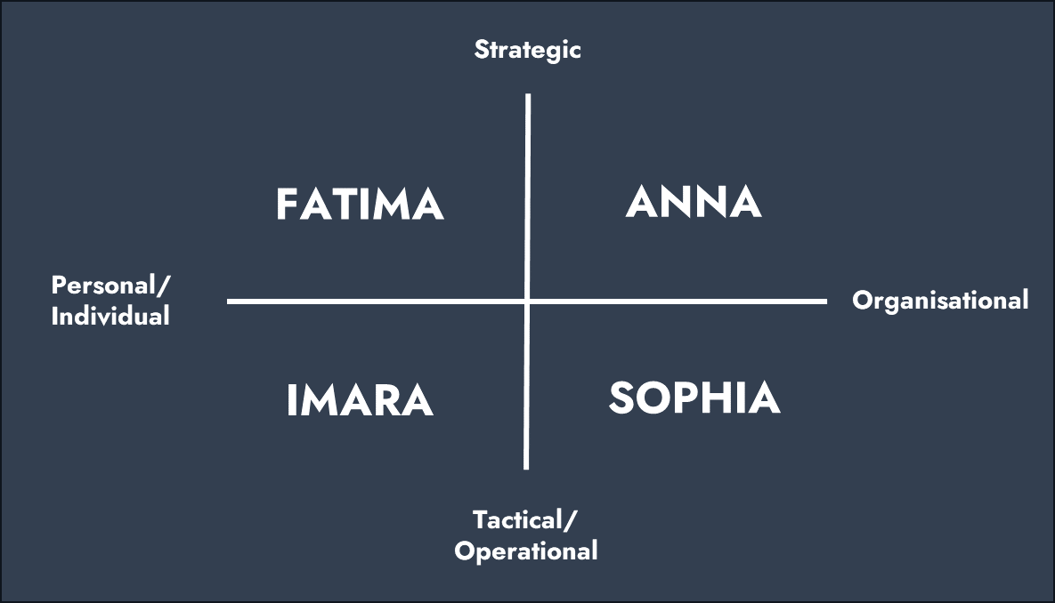
Case Anna
Career professional
Consultant management & change, offers support to (female) leaders in their development of managing staff in top positions.
Anna
CEO at DigitalTech (Branche: ICT and software development). Age 40+.
Issue
Rise of Artificial Intelligence and the impact of AI on the industry; the company must keep up with developments in order to maintain its market position.
Dilemma
Anna has doubts about her ability to make the right strategic decisions. She wonders if she has enough knowledge of AI. Male colleagues seem to be more confident.
Career question
Am I the right person to lead the company in this new direction? How can I overcome my uncertainties about making the right strategic decisions for the company?

Slide 15
Case Fatima
Career professional
Professional specialises in HR services in SME (small and medium-sized enterprises), offers support in the process of personnel planning.
Fatima
Operational manager at SME manufacturing company. <500 employees. Age 40+.
Issue
Ambition to digitise production (operations) and to motivate employees in embracing changes.
Dilemma
High level of resistance among employees (limited digital skills, fear of change, fear of job loss). Change in culture is needed among employees.
Career question
How can I overcome the challenges mentioned above and achieve success in the digital transformation, and simultaneously give my career a major boost and allow myself to be successful in my managing role?

Slide 16
Case Sophia
Career professional
Management Development mentor in a management development program, offering support for upcoming talent
Sophia
Project manager at Innovatech Solutions. Age 28. Participates in a Management Development trajectory.
Issue
Sophia is a successful and talented project manager who at the moment is faced with a decisive moment of choice regarding the continuation of her career
Dilemma
Sophia is confronted with a choice. There are multiple options, including: (1) a leading role at Innovatech Solutions; (2) specialisation in digital strategy & consultancy (outside of Innovatech). Sophia is dealing with the jealousy of others
Career question
How should I continue my career and give my career a boost while not letting the jealousy and negative talking of others cloud my judgement?

Slide 17
Case Imara
Career professional
HR advisor in a retail company.
Imara
Manager; climbed the career ladder to manager within the Finance & Administration department. Age 50+. 30 years of experience
Issue
Digitisation has been made a priority for senior MT. This means that all activities within the department will be digitised.
Dilemma
Imara and her team feel overwhelmed and incompetent and lack trust in digital solutions. Having to manage a team that does not support the decisions made whilst at the same time having doubts about herself.
Career question
Am I the right person for this job? Can me and my team learn to embrace the digital transformation or is there a need for me to look further? And in the latter case, what about the limitations of finding a new job that comes with my age?

Slide 18
PERSPECTIVE OF A COLUMNIST

Slide 19
DISCUSSION TASK The perspective of a columnist
"The business qualities that men are praised for are far from acceptable in women. Too strict, too bitchy, too businesslike. For many qualified women, this is a reason to lower their voice. After all, who wants to be left out of the group with "Iron Lady" stamped on their forehead? So, dear director of row three, the women you are seeking for your company are legion, but they are not so visible. They hold back until society is ready for them." Columnist Anne-Marije Buckens

Slide 21
References
Beck, K. (2019). „Beruflichkeit“ als wirtschaftspädagogisches Konzept – Ein Vorschlag zur Begriffsbestimmung. In: J. Seifried, K. Beck, B.-J. Ertelt, & A. Frey (Eds.), Beruf, Beruflichkeit, Employability. wbv. 19-33.
Hofer, M. (2015). Theoriebildung im Bereich der Beratung. In: B.-J. Ertelt; A. Frey; M. Scharpf (Ed.). Berufsberatung als Wissenschaft – Vier Jahrzehnte akademische Ausbildung für Berufsberaterinnen und Berufsberater in Mannheim. Hamburg: Kovač, 135-144.
Nilson, L. B. (2010). Teaching at its best: A research-based resource for college instructors, 2nd edition. San Francisco, CA: Jossey-Bass.

