Slide 1
DIGIGEN Up-Skilling Programme
Introduction

Slide 2
Digitalisation & Digital Transformation
New Work
Equality Efforts
Challenging Environment

Slide 3
V
U
C
A
Volatility
Uncertainty
Complexity
Ambiguity
Challenging Environment
Barber (1992)

Slide 4
Digitalisation
“Digitalization can be interpreted as the introduction of new solutions based on Information and communication technologies (ICTs)”
(Herberger et al. 2023; Herberger et al. 2021)

Slide 5
Digital Transformation
“Digital transformation addresses the implementation induced by digitalization and the associated changes and risks resulting from digitalization compared to the initial situation, which ultimately determines the consequences for all stakeholders also beyond the implementation issue.”
(Herberger et al. 2023; Herberger et al. 2021)

Slide 6
Relationship between Digitalisation and Digital Transformation
Herberger et al. (2023), Herberger et al. (2021)
Changes in Economic Dimensions
Digitalisation
Changes in Society Dimensions
Changes in … Dimensions
Digital Transformation

Slide 7
Digitalisation and Digital Transformation and their impact on women in management positions
Especially Women on a high-income level could be negatively affected by the digital tool AI. (Gmyrek et al. 2023)
Gender digital gap is an expression of the (negative) gender differences to which extent digital technologies and their design are available as power resources. (Lott 2023)

Slide 8
New Work
New Work refers to a form of work that is characterized by self-concordant action, time sovereignty and a high level of subjective well-being. This is achieved through interventions at the educational-psychological, organisational, technological and political levels. (Berend et al. 2020a)

Slide 9
New Work Elements
Berend et al. (2020b)
Spatial and temporal flexibilisation of work
Agile and project-based forms of organisation
New Work
Value-based and meaningful work
De-hierarchisation, participatory decision-making mechanisms and forms of self-organisation

Slide 10
Equality efforts
Herberger et al. (2023)
Many legal national and international initiatives for an enhanced women’s participation in working live (e. g. gender quotas)
Merely less initiatives which address women who are already in management positions and struggling e. g. with New Work and digitalisation.

Slide 11
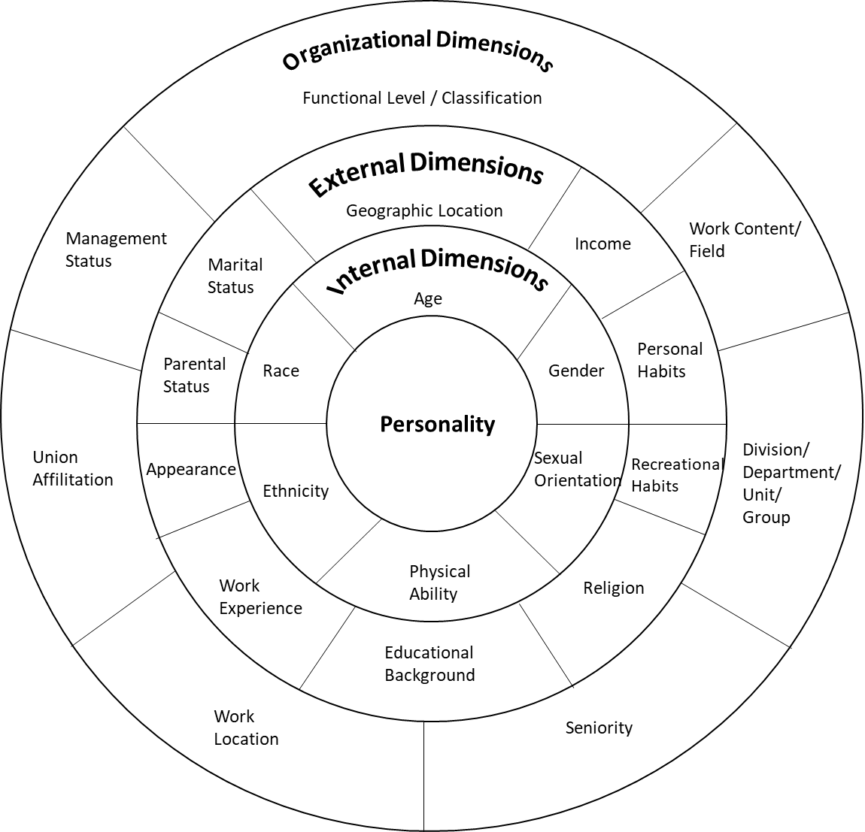
Diversity is a complex term and equality efforts are only one pattern
Gardenswartz et al. (2003)
Empowering women in management positions without weakening men in their career opportunities.
Aim is to counteract obvious disadvantages.
Diversity is more than equality and its facets generate interactions.

Slide 12
TARGET GROUPS

Slide 13
Target groups
Indirect Target Group
„Women in Management Positions“
Direct Target Group
„HR Practitioners and Career Counsellors“

Slide 14
Needs of women in management positions
Indirect Target Group
Herberger et al. (2023)
What are the futural changes induced by digitalisation and digital transformation?
More complicated / adaptability difficulties
Increased complexity / more techniques / tools
Easier, faster, more information

Slide 15
Needs of women in management positions
Indirect Target Group
Herberger et al. (2023)
What skills are necessary today and in the future for a successful work life?
Digital affinity / openness & willingness
Confident use / routine of digital technologies
Digital coordination & communication

Slide 16
Needs of women in management positions
Indirect Target Group
Herberger et al. (2023)
How would you like to learn useful skills and to achieve useful competencies?
A mixture of individual and group training
Digital training for digital tools
Learning by doing

Slide 17
Needs of HR Practitioners & Career Counsellors
Direct Target Group
Herberger et al. (2023)
What legal norms and initiatives are you aware of to promote women in management positions?
Legal standards related to gender equality / quotas
None known

Slide 18
Needs of HR Practitioners & Career Counsellors
Direct Target Group
Herberger et al. (2023)
Are you familiar with specific counselling approaches for women in management positions?
Non-specific general programs
Coaching / mentoring programs in general
Career networks

Slide 19
Needs of HR Practitioners & Career Counsellors
Direct Target Group
Herberger et al. (2023)
From your perspective which aspects are important in your counselling approach?
A personal environment
Creating a positive attitude
Creating awareness for complexity of the topic

Slide 20
OUR APPROACH

Slide 21
Intersection of topics
New Work
(focus on leadership)
Digitalisation
& Digital Transformation
Equality Efforts

Slide 22
Addressing this intersection:
Digital leadership
Female empowerment (without putting others at a disadvantage)
Counselling approach
Components of the up-skilling programme

Slide 23
Curriculum
2
4
Final Reflection
Introduction
Digital Organisation
Organisational Framework
1
3
5
Digital Leadership
Female Empowerment
Professional Counselling
DIGITAL LEADERSHIP
FEMALE LEADERSHIP
COUNSELLING
APPROACH

Slide 24
Outcomes
What are the outcomes of the programme?
An empowerment for female managers to handle the challenges of a modern (digitalised) working environment without discrimination of other genders.
Having an approach for reducing the negative effects of the VUCA-world for women.

Slide 26
References
Barber, H. (1992). Developing Strategic Leadership: The US Army War College Experience. Journal of Management Development, 11(6), pp. 4-12, https://doi.org/10.1108/02621719210018208.
Berend, B., Brohm-Badry, M. (2020a). Positive Psychologie und New Work. In M. Brohm-Badry, C. Peifer, J. M. Greve, & B. Berend (Eds.): Zusammen wachsen. Förderung der positiv-psychologischen Entwicklung von Individuum, Organisation und Gesellschaft. Lengerich, pp. 100–110.
Berend, B., Brohm-Badry, M. (2020b). New Work: Souveränität im postdigitalen Zeitalter – Zeitenwende für Unternehmer, Personalverantwortliche, Coaches und Angestellte. Wiesbaden.
Gardenswartz, L., & Rowe, A. (2003). Diverse Teams at Work - Capitalizing on the Power of Diversity. 2nd edition, Alexandria.
Gmyrek, P., Berg, J., Bescond, D. (2023). Generative AI and Jobs: A global analysis of potential effects on job quantity and quality. ILO Working Paper 96 (Geneva, ILO), https://doi.org/10.54394/FHEM8239.
Herberger, T., Dötsch, J. (2021). The Means Justifies the End? Digitalization and Sustainability as a Social Challenge. A Plea for an Integrative View. In Herberger, T.; Dötsch, J. (Eds.): Digitalization, Digital Transformation, and Sustainability in the Global Economy. Cham, pp. 1–8.
Herberger, T., Ertelt, B.-J., Scharpf, M., Reuter, A., Somogyi, S., Cserkúti, Á., Broersen, W., Etter Martin, S. (2023). Women, Leadership & Digitalization – Reports on Surveys in Germany, Hungary, and the Netherlands. ERASMUS+ DIGIGEN Project Ref. No. 2021-1-DE02-KA220-VET-000025335.
Lott, Y. (2023). Der Gender Digital Gap in Transformation? Verwendung digitaler Technologien und Einschätzung der Berufschancen in einem digitalisierten Arbeitsmarkt. WSI-Report, No. 81.

