Slide 1
FEMALE LEADERS WITH DIGITAL COMPETENCIES
Topic 1

Slide 2
LEADERSHIP THEORY
Traditional leadership theories
New forms of leadership
Digital Leadership Competencies
overview and outlook on theory

Slide 3
“Virtually all definitions of leadership share the view that leadership involves the process of influence. One thing that all leaders have in common is one or more followers. If no one is following, one cannot be leading.”
Vroom & Jago (2007)

Slide 4
TRADITIONAL LEADERSHIP THEORIES

Slide 5
Classification (Jago)
Jago (1982)
 | Universal Leadership | Contingent Leadership
Leader Traits | Universal Leader Traits “What are the traits of a succeeding leader?” | Contingent Leader Traits “How does a leader change the situation to be successful?”
Leader Behaviour | Universal Leader Behaviour “What is the behaviour of a succeeding leader?” | Contingent Leader Behaviour “How does a leader adapt to the situation to be successful?”

Slide 6
Universal Leader Traits
Leaders have universal, innate, and non-learnable characteristics/traits
→ Great Man Theory, Big-Five model, intelligence, sex, …

Slide 7
Traits Theory
Stogdill (1948)
Trait | Correlation with leadership |  | ø
 | Highest value | Lowest Value
Intelligence | .90 | -.14 | .26
School performance | .39 | -.27 | .16
Age | .71 | -.32 | .32
Body height | .71 | -.13 | .35
Body weight | .52 | -.04 | .26
Sociability | .98 | .10 | .50
Popularity | .82 | .23 | .60
→ Trait research from early leadership research cannot predict leadership success

Slide 8
Universal Leader Behaviour
Leaders have a universal, observable and learnable repertoire of behaviours
→ Ohio-State-Study/Iowa-Study, transactional/transformational leadership, charismatic leadership

Slide 9
GRID-Model (Blake/Mouton)
Blake & Mouton (1964)
9 | 1.9 |  |  |  |  |  |  |  | 9.9
8
7
6
5 |  |  |  |  | 5.5
4
3
2
1 | 1.1 |  |  |  |  |  |  |  | 9.1
 | 1 | 2 | 3 | 4 | 5 | 6 | 7 | 8 | 9
9.9 „Participative Leadership & Management“
5.5 „Compromising Style“
1.9 „Country-Club Management“
9.1 „Authority-Obedience Style“
1.1 „Impoverished Style“
Concern for people (relationship)
Decrease in Effectiveness
Concern for production (task)

Slide 10
Contingent Leader Traits
Leaders have innate traits, effective in certain conditions/situations
→ Contingency Model of Leadership Effectiveness (Fiedler)

Slide 11
Fiedler‘s Contingency Model (I)
Fiedler (1965)
Leadership Motivation
Leadership Effectiveness
Relationship-oriented (LPC ↑)
Task-oriented (LPC ↓)
* LPC: Least Preferred Co-Worker Scale
Productivity & Output
Situation Favourableness
Leader-Member Relations
Task Structure
Position Power

Slide 12
Fiedler‘s Contingency Model (II)
Fiedler (1965) & Jago (1982)
Decreasing Situational Favourableness
Favourable |  |  |  | Unfavourable |  |  | Unfavorable
Leader-Member Relations | Good | + | + | + | Poor | - | - | -
Task Structure | High | + | Low | - | High | + | Low | -
Position Power | Strong | Weak | Strong | Weak | Strong | Weak | Strong | Weak
Relationship-oriented | X | X | X | Match | Match | ? | ? | X
Task-oriented | Match | Match | Match | X | X | ? | ? | Match
Situation
Person
→ Leaders perform best when person and situation match

Slide 13
Contingent Leader Behaviour
Leaders have a repertoire of behaviours, adaptable to certain conditions/situations
→ Path-Goal Theory, Leader Member-Exchange Theory, Situational Leadership

Slide 14
Situational Leadership (Hersey/Blanchard)
Hersey & Blanchard (1977) & Holtbrügge (2012)
high
Support | Coach
Delegation | Direction
Performance readiness of followers (situation)
Psychological readiness (willingness)
Factual readiness (ability)
Leadership style (behaviour)
Task-oriented
Relationship-oriented
Ability (+)
Willingness (+)
Ability (0)
Willingness (0)
Relationsship-orientation
Ability (++)
Willingness (++)
Ability (-)
Willingness (-)
→ Leaders perform best when they adapt their leadership style to the performance readiness of each follower
low
low
Task-orientation
high

Slide 15
NEW
FORMS OF LEADERSHIP

Slide 16
Groupwork
Group 1: Positive Leadership – PERMA-Lead Concept
Group 2: Digital Leadership – VOPA+ Model
Group 3: Leader-Member-Exchange Theory
Group 4: Symbolic Leadership
Group 5: Servant Leadership

Slide 17
YOUR TASK Research your topic & present the leadership style
What constitutes the leadership style?
Where does the leadership style tie into traditional leadership theories?
Where does the leadership style differentiate itself from traditional leadership theories?
How does this leadership style fit into a digital context (opportunities/challenges)?
How is this leadership style to be classified in the context of female leadership (opportunities/challenges)?

Slide 18
DIGITAL LEADERSHIP COMPETENCIES

Slide 19
Digital Leadership I
DIGITAL LEADERSHIP
Understanding digital technology Creating value and achieving business goals
DIGITAL LEADER
Strategic use of the company’s digital assets and technology Using the latest technological develop-ments to foster digital transformation

Slide 20
Digital Leadership II
BETTER
AWARENESS
INFORMED DECISION-MAKING
“digital leaders achieve earnings growth that is 1.8 times higher than that of digital laggards—and more than double the growth in total enterprise value.”
ENHANCED CUSTOMER EXPERIENCE
IMPROVED BUSINESS OPERATIONS
bcg.com (2021)

Slide 21
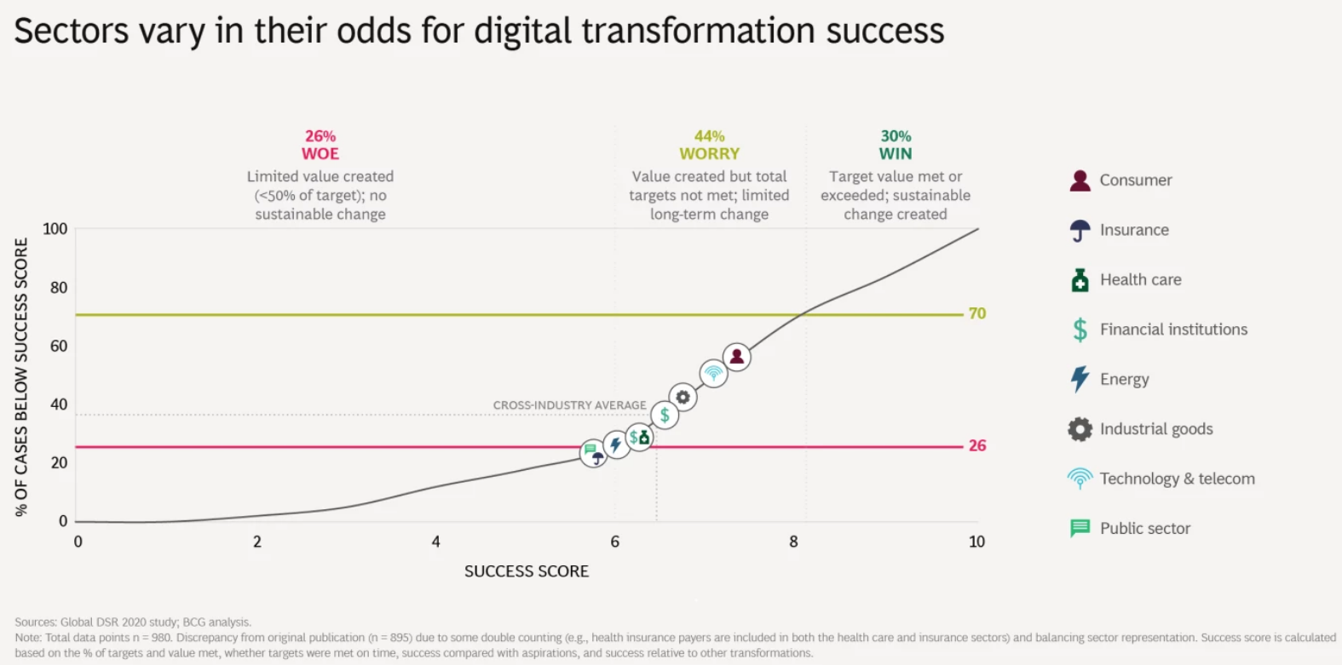
Digital Leadership III
bcg.com (2021)

Slide 22
Digital leadership competencies are the knowledge, skills, personal characteristics, self-concept, traits, and motives necessary to successfully and effectively lead organisations.
Ngayo Fotso (2021)

Slide 23
Leadership Competencies
Ngayo Fotso (2021)
A Perspective of Time – Leadership competencies for traditional leadership
Adaptability/Flexibility
Transformational Ability
Social Skills
Human Orientation
Organisational Skills
Values hard-working/results-driven/trustworthy
Cognitive Skills conceptual ability/intelligence
Self-awareness stress-resistant/confident/ purpose-driven
Communication Skills oral interaction

Slide 24
Leadership Competencies
Ngayo Fotso (2021)
A Perspective of Time – Leadership competencies for emerged leadership
+ Sharing Leadership
+ Handle Complexity
+ Knowledge
+ Global Leadership
Values + curious/authentic/optimistic/moral
Cognitive Skills + creative/critical/analytical/synthesise/strategic/entrepreneurial
Self-awareness + self-regulation/self-reflection
Transformational Ability + implementation ability
Communication Skills + indirect interaction

Slide 25
Leadership Competencies
Ngayo Fotso (2021)
A Perspective of Time – Leadership competencies for 21st century leadership
+ Collaboration
+ Customer-Centric Skills
+ Digital Competence
+ Financialisation Competence
+ Sustainability Competence
+ Crisis Management Competence
Knowledge + cross-functional competence

Slide 26
Groupwork
Digital Competencies
Group 1: “DigiComp 2.2” by European Commission (2022)
Group 2: “Building digital capabilities framework” by JISC (2022)
Group 3: “21st-century digital skills” by van Laar et al. (2017)
Digital Leadership Competencies
Group 4: “Key leadership competencies for digital transformation” by Philip et al. (2023)
Group 5: “Leadership competencies for digital transformation” by Gilli et al. (2022)

Slide 27
YOUR TASK Read the concept/text & present your competence framework
Which group (branch, job, position, …) does the competence framework address?
Where does this competence framework come from/which people’s view does it reflect?
What are digital (leadership) competencies from the authors’ point of view?
How is the competence framework structured?
How is the competence framework tied to female digital leadership?

Slide 28
Digital Competencies
van Laar et al. (2017, 2018) & CGC DigiTrans (2023)
 | Category | Differentiation
Core competencies | Information Management | Access/derive data; use/evaluate data; manage data
 | Communication | Appropriateness/expressiveness; create/share content; contact building; networking
 | Collaboration | Organise collaboration; knowledge sharing
 | Future Thinking | Critical reflection/justification; future orientation; creativity; problem-solving
 | Technical proficiency | Operate hardware; operate software; programming and maintenance; algorithms
Contextual competencies | Ethical awareness | Apply legal & ethical standards; understand digital impact
 | Cultural awareness | Understand cultural differences; cross-cultural collaboration
 | Flexibility | Adaptability; agility
 | Self-direction | Identify digital gaps; set learning goals; monitor learning process; pro-active/initiative
 | Lifelong learning | Explore new opportunities; create digital knowledge
 | Digital Safety | self-representation; support digital wellbeing; protect devices; protect data/privacy

Slide 29
Digital Leadership Competence
Imbery et al. (2022)
DIGITAL LEADERSHIP COMPETENCIES
Personal Competence
Action Competence
Social-communicative competence
Professional and methodological competence

Slide 30
Imbery et al. (2022) & Gilli et al. (2022) & Philip et al. (2023)
AGILITY
SHAPING AMBITIONS
ENERGY
ACTION COMPETENCE
TEAM LEADERSHIP
TRANSFORMATIONAL COMPETENCE

Slide 31
Imbery et al. (2022) & Gilli et al. (2022) & Philip et al. (2023)
DEVELOP DIGITAL TOOLS
CUSTOMER ORIENTATION
ORGANISATIONAL SKILLS
PROCESS INNOVATION
PROFESSIONAL &
METHODOLOGICAL
COMPETENCE
PROJECT MANAGEMENT
DATA ANALYSIS
PROBLEM-SOLVING
USE
DIGITAL TOOLS
DIGITAL
TREND EVALUATION

Slide 32
Imbery et al. (2022) & Gilli et al. (2022) & Philip et al. (2023)
SELF-AWARENESS
LIFELONG LEARNING
STRATEGIC THINKING
AUTONOMY
CROSS-DISCIPLINARY THINKING
PERSONAL
COMPETENCE
RESILIENZ
TOLERANCE OF AMBIGUITY
CHANGE ORIENTATION
CREDIBILITY

Slide 33
Imbery et al. (2022) & Gilli et al. (2022) & Philip et al. (2023)
RELATIONSHIP SKILLS
COMMUNICATION SKILLS
SOCIAL-COMMUNICATIVE
COMPETENCE
TEAM ORIENTATION
COLLABORATION SKILLS

Slide 35
References
Blake, R.R., Mouton, J.S. (1964). The Managerial Grid: The Key to Leadership Excellence. Houston, Gulf Publishing.
Boston Consulting Group (2021). Which Sectors Perform Best in Digital Transformation? Online available under: https://www.bcg.com/publications/2021/learning-from-successful-digital-leaders, last accessed on the 21.09.2023.
CGC DigiTrans (Ed.) (2023). CGC-DigiTrans Report. Mannheim.
Fiedler, F.E. (1965). Engineer the Job to Fit the Manager. Harvard Business Rev. 43 (5), 115-122.
Gilli, K., Nippa, M., Knappstein, M. (2023). Leadership competencies for digital transformation: An exploratory content analysis of job advertisements. German Journal of Human Resource Management: Zeitschrift für Personalforschung 37 (1), 50-75.
Hersey, P., Blanchard, K.H. (1977). Management of Organizational Behavior: Utilizing Human Resources. 3rd edition. New Jersey/Prentice Hall.
Holtbrügge, D. (2012). Personalmanagement. 5th edition. Berlin/Heidelberg: Springer Gabler.
Imbery, S., Rowbotham, M., Lindemann, M., Gruninger-Hermann, C., Schirmer, U. (2022). Digital-Leadership-Kompetenzkatalog. Mit den richtigen Kompetenzen die digitale Transformation gestalten. zfo (2), 98-104.
Jago, A.G. (1982). Leadership: Perspectives In Theory And Research. Management Science 28 (3), 315-336.
Ngayo Fotso, G.M. (2021). Leadership competencies for the 21st century: a review from the Western world literature. European Journal of Training and Development 45 (6/7), 566-587.

Slide 36
References
Philip, J., Gilli, K., Knappstein, M. (2023). Identifying key leadership competencies for digital transformation: evidence from a cross-sectoral Delphi study of global managers. Leadership & Organization Development Journal 44 (3), 392-406.
Stogdill, R.M. (1948). Personal Factors Associated with Leadership: A Survey of the Literature. Journal of Psychology 25, 35-71.
van Laar, E., van Deursen, A. J.A.M., van Dijk, J. A.G.M., de Haan, J. (2017). The relation between 21st-century skills and digital skills: A systematic literature review. Computers in Human Behavior 72, 577-588.
van Laar et al (2018). 21st-century digital skills instrument aimed at working professionals: Conceptual development and empirical validation. Telematics and Informatics 35, 2184 -2200.

