Slide 1
FEMALE
LEADERS IN A
DIGITAL CONTEXT
Topic 2

Slide 2
Digitalisation & Digital Transformation
Modern Technologies for SMEs
Knowledge Management and Tools
Workflow Management and Tools
Enterprise Data Management and Tools
Digital Leadership
DIGITAL MANAGEMENT TOOLS
DEFINITION, BASIC TERMINOLOGY
IMPORTANCE FOR ENTREPRENEURS
TOOLS
PROCESSES

Slide 3
1. DIGITALISATION AND DIGITAL TRANSFORMATION
1.1. DEFINITIONS
DIGITISATION
Converting from analogue to digital
e.g. scanning
DIGITALISATION
Combining digitised data with technological tools
e.g. file sharing
DIGITAL TRANSFORMATION
Use of new technology to transform processes
e.g. automated processes in sales
TASK 1. INDIVIDUAL WORK: HANDOUT 1.

Slide 4
1. DIGITALISATION AND DIGITAL TRANSFORMATION
1.2. DRIVERS OF DIGITAL TRANSFORMATION
New business models
Customer experience and expectations
Modernising IT infrastructure
Operational efficiency
Updating employee skills
Data visibility and security
Collaboration with stakeholders

Slide 5
GROUP DISCUSSION
Task 2
What is slowing down digital transformation at enterprises?
What could be the main barriers?
Video: “5 Most Important Elements of Digital Transformation”
→ Compare anticipations

Slide 6
1. DIGITALISATION AND DIGITAL TRANSFORMATION
1.3. CURRENT DIGITAL TRANSFORMATION TRENDS
LOW-CODE or NO-CODE PLATFORMS
Simplified solutions for application development
Reducing development costs
AUTOMATION
Cut down on repetitive work
Improving productivity
BLOCKCHAIN
Shared database of expanding data blocks
Virtual team or document collaboration
CLOUD TECHNOLOGY
Fast and easy solutions for remote work, collaboration, data availability and security
ARTIFICIAL INTELLIGENCE (AI) AND MACHINE LEARNING (ML)
For storage and infrastructure
Analyse interactions
Estimate future patterns

Slide 7
1. DIGITALISATION AND DIGITAL TRANSFORMATION
1.4. FUTURE DIGITAL TRANSFORMATION TRENDS
MOBILE INTERNET
VR AND AR
CLOUD
AI AND ML
INTERNET OF THINGS (IoT)
ADVANCED ROBOTICS
BIOMETRIC TECHNOLOGY
3D PRINTING
GENOMICS
BLOCKCHAIN

Slide 8

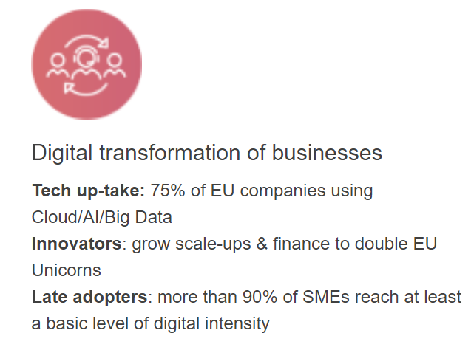
1. DIGITALISATION AND DIGITAL TRANSFORMATION
1.5. FUTURE DIGITAL TRANSFORMATION TRENDS
Europe’s Digital Decade: digital targets for 2030

Slide 9
2. MODERN TECHNOLOGIES FOR SMEs
2.1. Modern technologies A-Z
Artificial intelligence
Augmented Reality
Big data
Blockchain
Cybersecurity
Internet of Things
Machine Learning
Virtual reality

Slide 10
CHECKING ON
DIGITAL PERFORMANCE
Task 3: Individual Work
DIGITAL ECONOMY AND SOCIETY INDEX (DESI)
  What is your country’s DESI index? How does it compare with EU countries? What are the key areas?
  What’s the level of inclusion of women in digital jobs in your country? Check the WiD scoreboard.
EUROPEAN DIGITAL INNOVATION HUBS (EDIHs)
  What are EDIHs?
  How can they help SMEs to respond to digital challenges?

Slide 11
2. MODERN TECHNOLOGIES FOR SMEs
2.2. Importance for entrepreneurs
Benefits
Efficiency and productivity
Cost savings
Global presence
Data management and analysis
Improved customer engagement
Remote work and collaboration
Cybersecurity

Slide 12
2. MODERN TECHNOLOGIES FOR SMEs
2.3. Process and requirements of implementing modern technologies to empower businesses
1. Define objectives and use cases
2. Assess technical readiness
3. Allocate resources
4. Select the right technology and partners
5. Pilot testing and training

Slide 13
2. MODERN TECHNOLOGIES FOR SMEs
2.4. Types of solutions available for enterprises
AI
Chatbot for Customer Support
AR/VR
AR Product Catalogue
Virtual Training Simulation
BIG DATA
Customer Segmentation and Personalisation
Sales Forecasting with Predictive Analytics
Personalised Email Marketing Campaign
AR Interactive Marketing
Demand Forecasting
Social Media Analytics
CYBERSECURITY
Employee Security Training
Multi-Factor Authentication (MFA) Implementation
Vulnerability Assessment

Slide 14
PRACTICAL USE OF MODERN TECHNOLOGIES
Task 4: Individual Work
Download and try out Google Lens which is a visual search technology developed by Google that uses machine learning, image recognition, and augmented reality (AR) to provide information and insights about objects in the real world. It allows users to interact with their surroundings using their smartphone camera to identify, interpret, and learn more about various objects, images, and text.
→ Think about the potential benefits and areas of
application for SMEs.

Slide 15

3. KNOWLEDGE MANAGEMENT AND TOOLS
3.1. DEFINITION
KNOWLEDGE MANAGEMENT:
Systematic management of knowledge and information within an organisation which results in streamlined business processes.

Slide 16
3. KNOWLEDGE MANAGEMENT AND TOOLS
3.2. IMPORTANCE FOR ENTREPRENEURS
IMPROVED DECISION MAKING PROCESS
BETTER SKILLS IDENTIFICATION
MAINTAINING KNOWLEDGE
BETTER COMMUNICATION
INCREASED DATA SECURITY

Slide 17
3. KNOWLEDGE MANAGEMENT AND TOOLS
3.3. KNOWLEDGE MANAGEMENT PROCESS
DISCOVER
  Define already existing or new knowledge
  Consider individual, group and organisational level
CAPTURE
  Collect the knowledge defined
  Consider explicit, implicit and tacit knowledge
ORGANISE
  Organise the relevant knowledge collected
  Consider knowledge management systems
ASSESS
  Double check and validate information
  Filter redundancies
DISTRIBUTE
  Make the knowledge public
  Restrict information to groups

Slide 18
3. KNOWLEDGE MANAGEMENT AND TOOLS
3.4. KNOWLEDGE MANAGEMENT MATURITY LEVELS
Adapted from: APQC’s Levels of Knowledge Management Maturity
LEVEL 1: INITIATE
LEVEL 2: DEVELOP
Localised and repeatable practices
LEVEL 3: STANDARDISE
Common processes and approaches
LEVEL 4: OPTIMISE
LEVEL 5: INNOVATE
Measured and adaptive
Continuously growing practice
Growing awareness
Applied Knowledge
Leveraged Knowledge
Ad Hoc Knowledge
Dynamic Knowledge

Slide 19
3. KNOWLEDGE MANAGEMENT AND TOOLS
3.5. TYPES OF KNOWLEDGE MANAGEMENT TOOLS
KNOWLEDGE BASE
LEARNING MANAGEMENT SYSTEMS
CUSTOMER RELATIONSHIP MANAGEMENT
CONTENT MANAGEMENT SYSTEMS
Self-service library of
information
Platforms for managing
learning programmes
Systems for managing
client information
and interaction
Systems for creating,
managing and modifying
company website

Slide 20
CHECKING ON
KNOWLEDGE MANAGEMENT
Task 5: Individual Work
  Familiarise yourself with the best knowledge management software tools by watching „7 Best Knowledge Management Software Tools in 2023”.
  Check one tool in detail (e.g., Small Business Knowledge Management with Process Street) and answer:
    What functionalities does the software offer?
    What are the benefits of using the tool?
    Who is it recommended for?
  Look for success stories, case studies or testimonials of companies using the product. (e.g., Process Street case studies)

Slide 21
4. WORKFLOW MANAGEMENT AND TOOLS
4.1. DEFINITION
BUSINESS PROCESS MANAGEMENT:
Discovery, modelling, analysis, measurement and optimalisation of business processes.
BUSINESS PROCESS MANAGEMENT
PROJECT MANAGEMENT
WORKFLOW MANAGEMENT
PROJECT MANAGEMENT:
Planning and organisation of a company’s tasks and resources to achieve project completion.
WORKFLOW MANAGEMENT:
The process of creation, organisation and monitoring a set of any tasks which contribute to successful business management and enhance productivity.

Slide 22

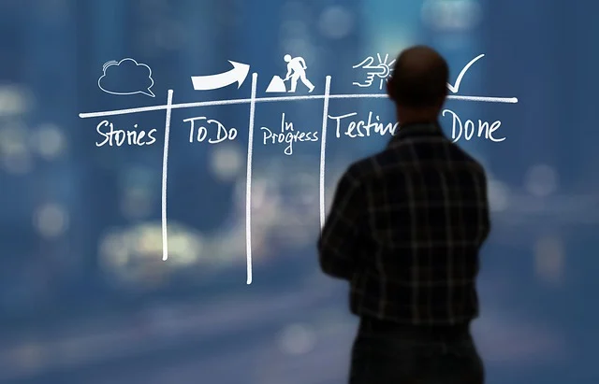

4. WORKFLOW MANAGEMENT AND TOOLS
4.2. IMPORTANCE FOR ENTREPRENEURS
IDENTIFICATION OF INEFFICIENCIES
REDUCING COSTS
BETTER VISIBILITY
IMPROVED COMMUNICATION
AND COLLABORATION
INCREASED PRODUCTIVITY

Slide 23
4. WORKFLOW MANAGEMENT AND TOOLS
4.3. WORKFLOW MANAGEMENT PROCESS
Collecting and identifying operating procedures
Understanding task completion
Enlisting relevant stakeholders
Visualising the process
Testing and optimisation

Slide 24
4. WORKFLOW MANAGEMENT AND TOOLS
4.4. TYPES OF WORKFLOW MANAGEMENT TOOLS
94% of workers say they perform repetitive, time-consuming tasks in their role
2 out of 3 knowledge workers say automation has helped them be more productive at work
9 out of 10 knowledge workers say that automation has improved people’s lives in the workplace
65% of knowledge workers are less stressed at work because they automate manual tasks
Two-thirds of knowledge workers would recommend automation to other businesses
88% of SMEs say automation allows their company to compete with larger companies
COMMON FEATURES:
Data visibility and security
Easy to use
Cloud based
Integration with other applications
Customisable
Mobile friendly
TOP FIELDS OF USE:
Project Management
Sales and Marketing
Finance
Customer Service
Human Resource Management
Source: State of business automation. Adapted from: Zapier

Slide 25

CHECKING ON
WORKFLOW MANAGEMENT
Task 6: Individual Work
  Familiarise yourself with the best workflow software by watching „The 10 Best Workflow Management Software Reviewed”
  Check one tool in detail (e.g., Kissfow Workflow demo) and answer:
    What functionalities does the software offer?
    What are the benefits of using the tool?
    Who is it recommended for?
  Look for success stories, case studies or testimonials of companies using the product. (e.g., Kissflow success stories )

Slide 26
CREATING A
WORKFLOW DIAGRAM
Task 7: Individual Work
  → DESIGN YOUR OWN WORKFLOW DIAGRAM
  Choose a specific task (e.g., counselling process) to create the workflow.
  Define the purpose, gather necessary data, design the process, and analyse the result.
  For visualisation, use any free online tool available on the internet.
  HINTS: Canva, Wondershare Edraw Max (tutorial video)

Slide 27


5. ENTERPRISE DATA MANAGEMENT AND TOOLS
5.1. DEFINITION
Enterprise Data Management is the process of inventorying and governing business data and transforming it into smooth flow of information for further use.

Slide 28
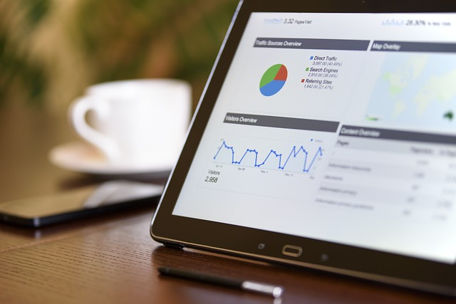
5. ENTERPRISE DATA MANAGEMENT AND TOOLS
5.2. IMPORTANCE FOR ENTREPRENEURS
Higher level of productivity
Smoother workflows
Decreased security risks
Cost efficiency
Reduced threat of data loss
Improved decision-making processes

Slide 29
5. ENTERPRISE DATA MANAGEMENT AND TOOLS
5.3. ENTERPRISE DATA MANAGEMENT PROCESS AND STRATEGY
Assessment of the current situation
Identification of a suitable tool
Creation of data governance policies
Definition of current needs and final objectives
Implementation of the data management solution
Training of employees

Slide 30
5. ENTERPRISE DATA MANAGEMENT AND TOOLS
5.4. TYPES OF ENTERPRISE DATA MANAGEMENT TOOLS
Behavioural data management tools
Business intelligence
Customer data management tools
Data warehouse management
Product analytics data management

Slide 31

6. DIGITAL LEADERSHIP
6.2. ETHICS OF DIGITAL LEADERSHIP (DIGITAL ETHICS)
Digital ethics = system of values and moral principles to guide electronic interactions among people, organisations and things. (Gartner)
Ethical leadership involves:
  Ethical data stewardship,
  Engagement in ethical partnerships and collaborations,
  Being advocates of the ethical considerations.

Slide 32
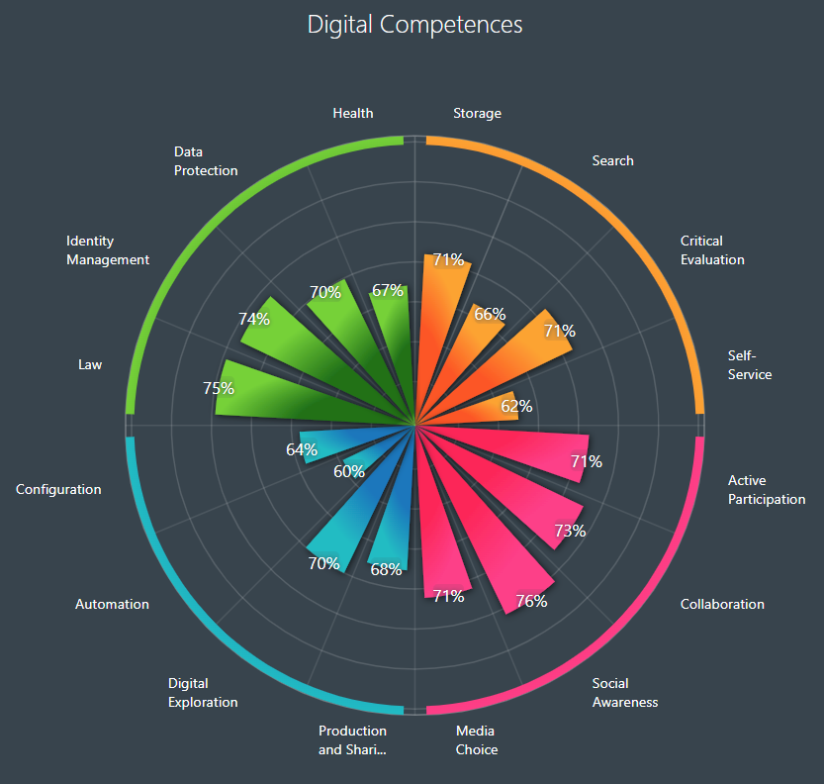
CHECKING ON
DIGITAL LEADERSHIP
Task 8: Individual Work and Group Work
  → WHAT ARE YOUR DIGITAL COMPETENCE AREAS?
  Complete the Digital Competence Wheel survey. What are your strengths and areas for improvement?
  → Think of/Discuss how this (or any similar tool) could be used in your counselling work.

Slide 34
References
Business Solution (2023) 7 Best Knowledge Management Software Tools in 2023, accessed 18 August 2023, https://www.youtube.com/watch?v=SHdspGNcD_I.
Canva website, accessed 21 August 2023, https://www.canva.com/.
European Digital Innovation Hubs Network, European Commission website, accessed 14 August 2023, https://european-digital-innovation-hubs.ec.europa.eu/home.
Europe’s Digital Decade: digital targets for 2023, accessed 06 November 2023, https://commission.europa.eu/strategy-and-policy/priorities-2019-2024/europe-fit-digital-age/europes-digital-decade-digital-targets-2030_en.
Google Lens, Google Play website, accessed 28 September 2023, https://play.google.com/store/apps/details?id=com.google.ar.lens&hl=hu&pli=1.
Hubert, Cindy and Lemons, Darcy, 2019, APQC's Levels of Knowledge Management Maturity, accessed 06 November 2023, https://www.apqc.org/resource-library/resource-listing/apqcs-levels-knowledge-management-maturity.

Slide 35
References
Ionology (2022) 5 Most Important Elements of Digital Transformation, accessed 14 August 2023, https://www.youtube.com/watch?v=Qkw41DTrLt8&list=RDLVFjAq1xjBv_4&index=16.
Kissflow Success Stories, Kissflow website, accessed 21 August 2023, https://kissflow.com/success-stories/.
Kissflow, Kissflow Workflow – Overwiew, accessed 21 August 2023, https://www.youtube.com/watch?v=9v_ob4MwukQ&list=PL891ahseKXxfby1AnVnry0S_K39hpePWT&index=17.
Process Street Helped Leverage Retain Knowledge & Increase Efficiency, Process Street website, accessed 17 August 2023, https://www.process.st/category/case-study/.
Process Street (2014) Small Business Knowledge Management with Process Street, accessed 18 August 2023, https://www.youtube.com/watch?v=vdYYcuRVFl0.
The Digital Competence Wheel website, accessed 23 August 2023, https://digital-competence.eu/dc/en/.

Slide 36
References
The Digital Economy and Society Index (DESI), European Commission website, accessed 14 August 2023, https://digital-strategy.ec.europa.eu/en/policies/desi.
The Digital Project Manager, The 10 Best Workflow Management Software Reviewed, accessed 21 August 2023, https://www.youtube.com/watch?v=bPcx_XMLXkM.
Wondershare EdrawMax website, accessed 21 August 2023, https://www.edrawmax.com/.
Wondershare Edraw, Workflow Diagram Tutorial: How to Create a Workflow Diagram, accessed 21 August 2023, https://www.youtube.com/watch?v=Bjifg2wWZkQ.
Zapier Editorial Team, 2021, Zapier report: The 2021 state of business automation, Cflow website, accessed 06 November 2023, https://zapier.com/blog/state-of-business-automation-2021/.
Remark:
For background information on all topics, please refer to the Reader. Please note that the majority of the background material (videos, articles) is in English. If the participants face difficulties in using English language, consider using a translator or find similar materials in the national language used by the participants.

