Slide 1
PROFESSIONAL
COUNSELLING
PBL Presentation
Topic 5b – Practical Approaches

Slide 2
Numeration of approaches I
BACKGROUND
Introduction: resistance
Neuropsychology: how the brain works
WHAT IS THE FOCUS OF THE FEMALE LEADER?
Circle of influence (Covey) & Social cultural theory of cognitive development (Vygotsky)
Mindset (Dweck)
From Drama Triangle to Winners Triangle (Karpman)
Influence of the undercurrent (McClelland)
Core Qualities (Ofman)
Stages of behavioural change (Diclemente & Prochaska)

Slide 3
Numeration of approaches II
INTERVENTIONS IN INFLUENCING BEHAVIOURAL PATTERNS
Theory U
Appreciative Inquiry / positive psychology
Motivational interviewing (McClelland)
  Undercurrent: problem or solution-oriented thinking in possibilities or solutions
  Thoughts and beliefs of the female manager
Change language / Reframing thoughts

Slide 4
BACK-GROUND

Slide 5

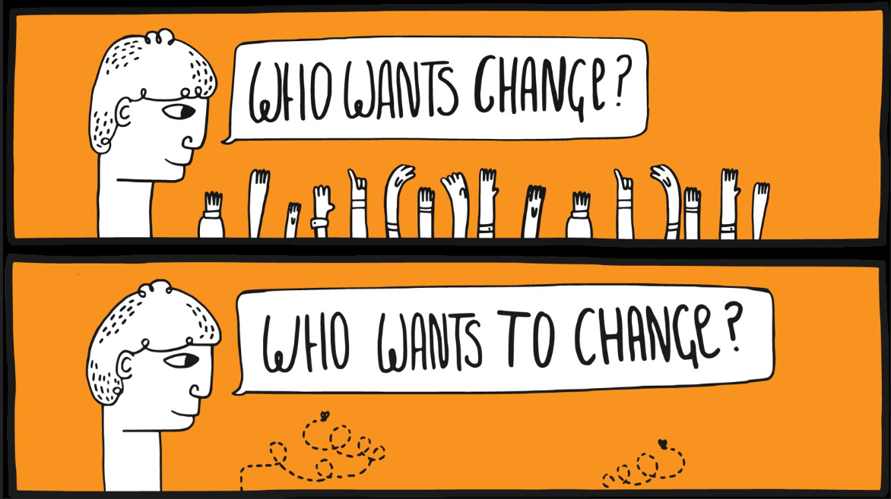
Introduction: resistance
1
Source: https://www.flickr.com/photos/toddle_email_newsletters/21031243458

Slide 6
Be aware of resistance
1
Unwillingness: there is no commitment
Inability: there is doubt about one’s ability
Circumstances: there are developments or changes in the situation
Lack of clarity: for example, on agreements
Dissatisfaction: disagrees with the way the goals are to be achieved
Judgement: asking for help means weakness? Resistance to the system.

Slide 7
Neuropsychology
2
WHY IS BEHAVIOURAL CHANGE SO DIFFICULT?
Our brain needs simplicity→ fully automatic processes (habits) work easier for us
  Avoiding loss, pain and discomfort
  Social relationships have much influence (to maintain old behaviour...)
Changing habits requires persistence and practice
Fun works: changing something you really want is easier
Support is essential; in this case: your coaching/counselling
Notes:
More Information to read:
2018- Berkman- The neuroscience of goals and behavioral change

Slide 8
FOCUS OF THE FEMALE LEADER

Slide 9
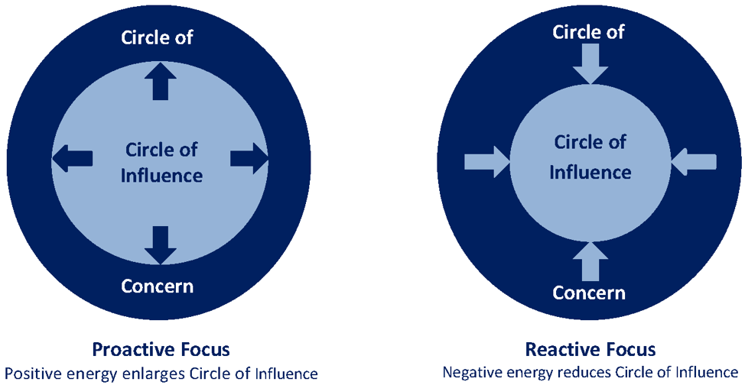
Circle of influence (Covey) I
3
There are two ways to ensure that the circle of influence overlaps the circle of concern:
By expanding your circle of influence. This can be done by addressing what is bothering you.
By using your strengths (“What can
I do differently myself?") and social
skills to get other people to change
Source: https://www.abrahampc.com/blog/2020/3/16/what-can-i-do-the-circles-of-concern-and-influence
Notes:
More Information to read:
1996 Coveys_seven_habits_and_the_systems_approach_a_comparative_analys

Slide 10
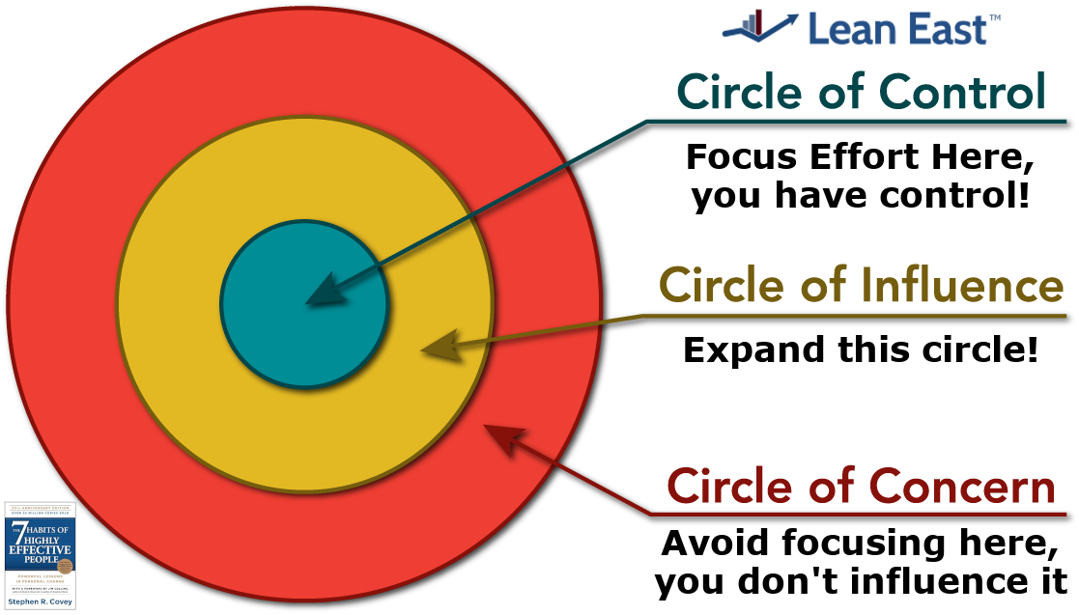
Circle of influence (Covey) II
3
WHERE DOES THE COACHEE PUT HER ENERGY?
The problems we face fall into three categories:
Direct influence (problems related to our
behaviour);
Indirect influence (problems related to
others' behaviour);
No influence (problems we cannot do
anything about. For example, things that
happened in the past or aspects of the environment).
Source: https://www.leaneast.com/7-habits
Notes:
More Information to read:
1996 Coveys_seven_habits_and_the_systems_approach_a_comparative_analys

Slide 11
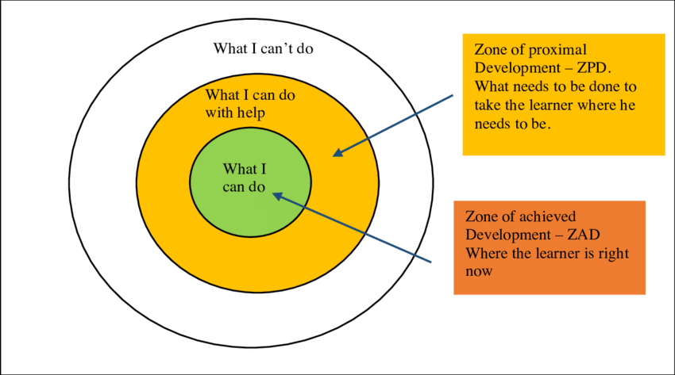
Sociocultural Theory of Cognitive Development (Vygotsky)
3
Source: https://educationaltechnology.net/vygotskys-zone-of-proximal-development-and-scaffolding/

Slide 12
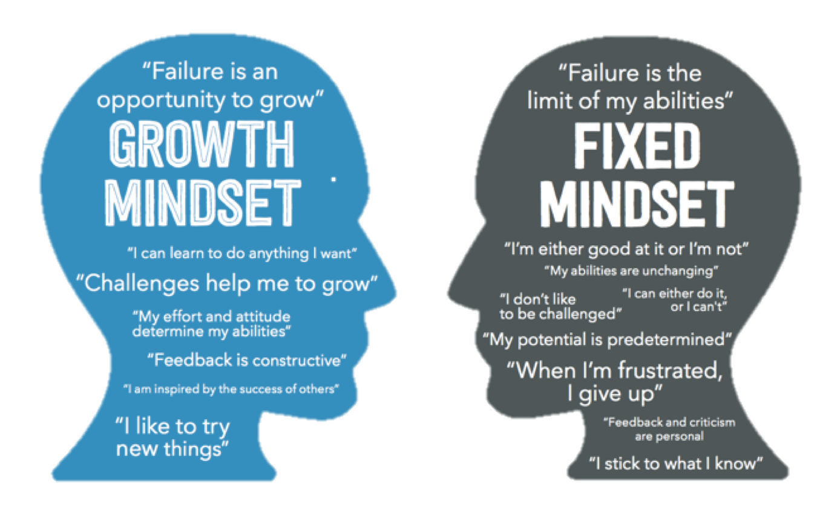
Mindset (Dweck)
4
Source: https://www.specializedtherapy.com/the-fixed-mindset-and-its-ability-to-impact-life-and-learning/
Notes:
More Information to read:
https://fs.blog/carol-dweck-mindset/
2019 Dweck& Yeager--Mindsets-a-view-from-two-eras

Slide 13
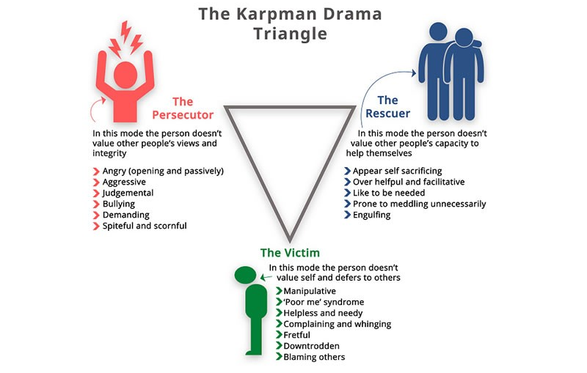
Drama Triangel (Karpman)
5
POSITIONS IN COMMUNICATION:
STAY AWAY FROM THE DRAMA TRIANGLE
Source: https://firststeprehab.co.za/drama-triangle/

Slide 14
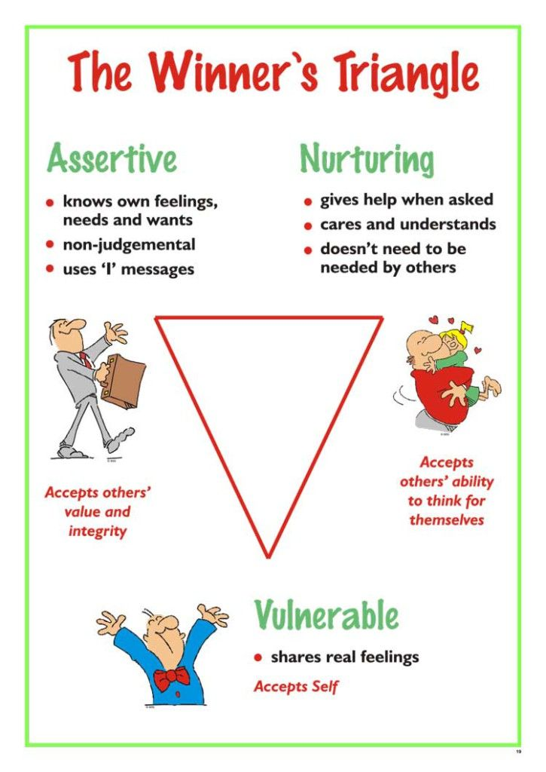
How? → Winner’s triangle
5
Source: https://nl.pinterest.com/pin/221450506658142540/

Slide 15
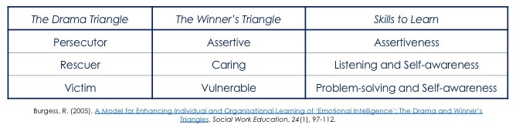
I am okay, you are okay
5
Instead of saving | I am committed to helping the other person with identifying and solving his or her problem while helping the other take responsibility.
Instead of engaging in victim behaviour | I will ask others for help and I will start taking action. I commit myself to achieve realistic goals that are important to me.
Instead of suing | I will think along and build a better situation for myself and others.

Slide 16
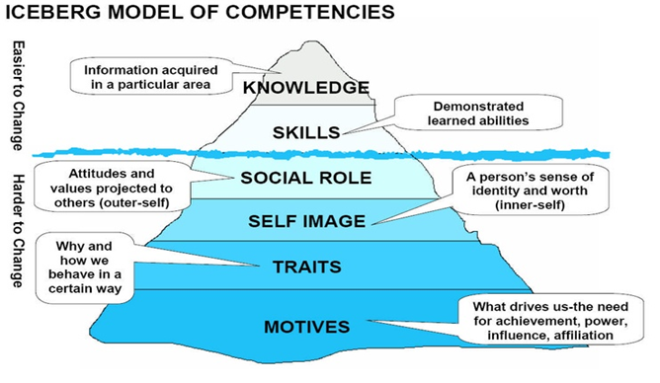
Influence of the undercurrent (McClelland)
6
Observable ..... for others
→ Raising awareness ‘easy’
What are you doing?: behaviour
Unobservable ...to others
→ Raising awareness 'more difficult’
What do you think?: behaviour, feelings and thoughts (BFT)
What do you want?: self-knowledge, self-image, personal mission, BFT as trigger or consequence
Source: https://exeqserve.com/iceberg-need-build-competency-model-ed-ebreo/

Slide 17
Undercurrent
6
When people do not feel heard or feel their opinions are ignored.
When people complain a lot but do not discuss this in a meeting or directly to the person concerned.
When 'yes' is said to a proposal, yet it is not done.
When all sorts of excuses are made as to why it couldn't be done anyway.
WE OFTEN DO NOT SPEAK QUIETLY AND OPENLY ABOUT THIS BUT HAVE ALL SORTS OF WAYS OF RESISTING IT.

Slide 18
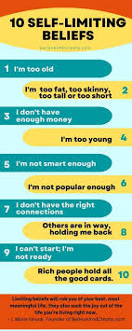
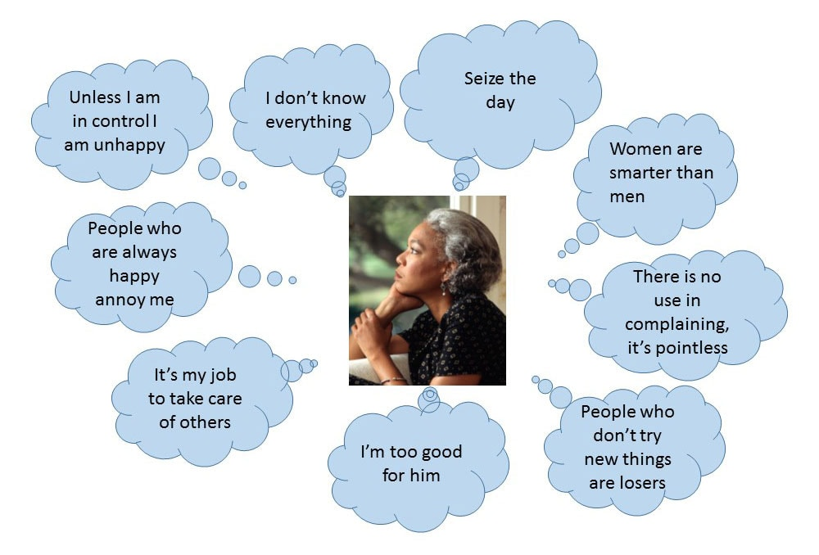
Barriers and possibilities
6
THINKING IN BARRIERS → THINKING IN POSSIBILITIES
Source: https://beta.elsevier.com/connect/the-5-most-powerful-self-beliefs-that-ignite-human-behavior?trial=true

Slide 19
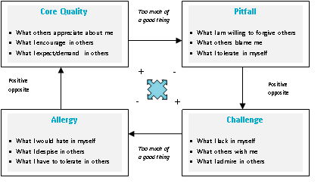
Core Qualities (Ofman)
7
Source: https://www.arteveldehogeschool.be/spotlight/node/93/
Notes:
More to watch
https://www.youtube.com/watch?v=gFxr8GBiEoI
https://www.youtube.com/watch?v=mtRgHQjun0Q
More to read
https://www.corequality.nl/?lang=en

Slide 20
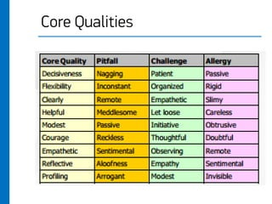
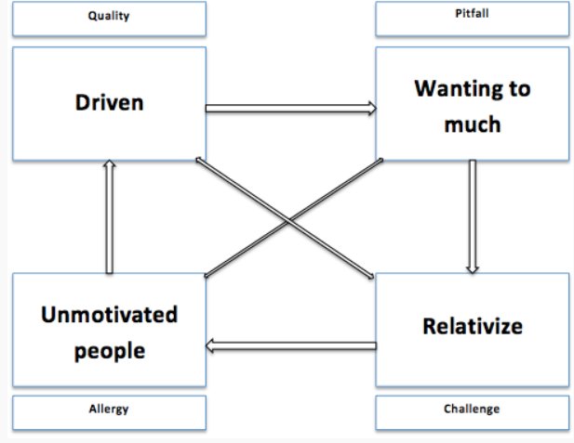
Examples
7
Source: https://dyonhoekstra.weebly.com/daniel-ofmans-model-of-core-quadrants.html
Source: https://www.slideshare.net/Harizmalife/core-quality

Slide 21
Stages of behavioural change
8
No | Stage name | What coachee shows | What to do?
1. | Precontemplation | Not seriously thinking about change | Acknowledging ambivalence
2. | Contemplation | Seriously considering change | Focus on seeking Balance, changing direction
3. | Preparation | Willingness to change, plan for change | Formulate SMART goals
4. | Action | Putting new behaviour into practice | Guide/support
5. | Maintenance | Maintaining the new way of life if the action is successful | Learning to learn
Prochaska, J. O., & DiClemente, C. C. (1983). Stages and processes of self-change of smoking: Toward an integrative model of change. Journal of Consulting and Clinical Psychology, 51(3), 390–395. https://doi.org/10.1037/0022-006X.51.3.390
Notes:
The model provides a framework when interpreting events in a single conversation, but also between conversations. Clients can start at a stage of precontemplation, then quickly march towards preparation, but then lapse back to contemplation and even precontemplation. It may also be that you have made plans with a client, and next week your client reports that everything is going perfectly, but then two weeks later comes sadly to tell you that the plan makes no sense after all... Examples: quitting smoking or drinking, moving more/eating less, losing weight... People often fall back into problem behaviour or unwanted behaviour more than once, going through multiple cycles through the stages of trial and error.
As a coach, the trick is to (continue to) move (=motivate) the client towards action and maintenance.

Slide 22
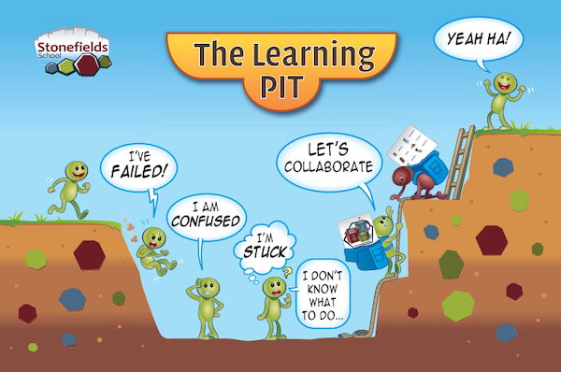
The learning pit – Thougths
8
Source: https://www.structural-learning.com/post/the-learning-pit-a-guide-for-teachers

Slide 23
INFLUENCING BEHAVIOURAL PATTERNS

Slide 24
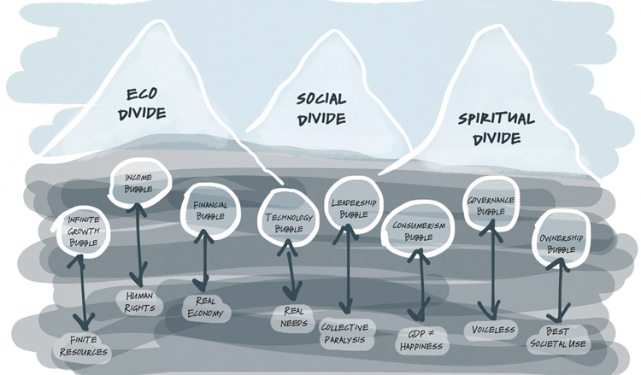
Theory U (Scharmer)
9
Theory U is about personal leadership and a different way of thinking.
Contributes to transitions for complex issues of change
Source: http://www.goingupstream.net/blog/november-12th-2017
Notes:
More reading?
https://www.toolshero.com/leadership/theory-u-scharmer/
2004 Scharmer-Theory_U_Leading_profound_innovation_and_change
2018 Heller- Critical analysis of Scharmers Theory U

Slide 25
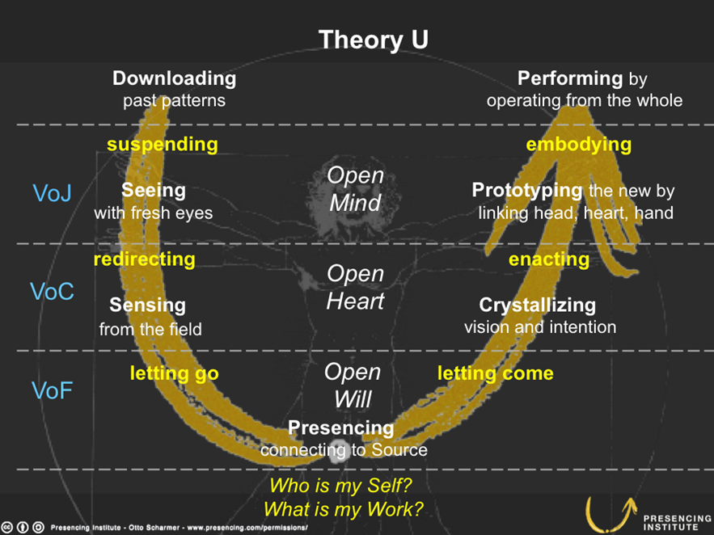
Phases
9
The U-process consists of 7 phases. The phases together comprise a conscious process of connection to arrive at substantially different outcomes and innovation. In each phase, the other phases are also present. This makes it a cyclical process.
Downloading
Seeing
Sensing
Presencing
Crystallizing
Prototyping
Performing
Source: https://en.wikipedia.org/wiki/Theory_U2

Slide 26
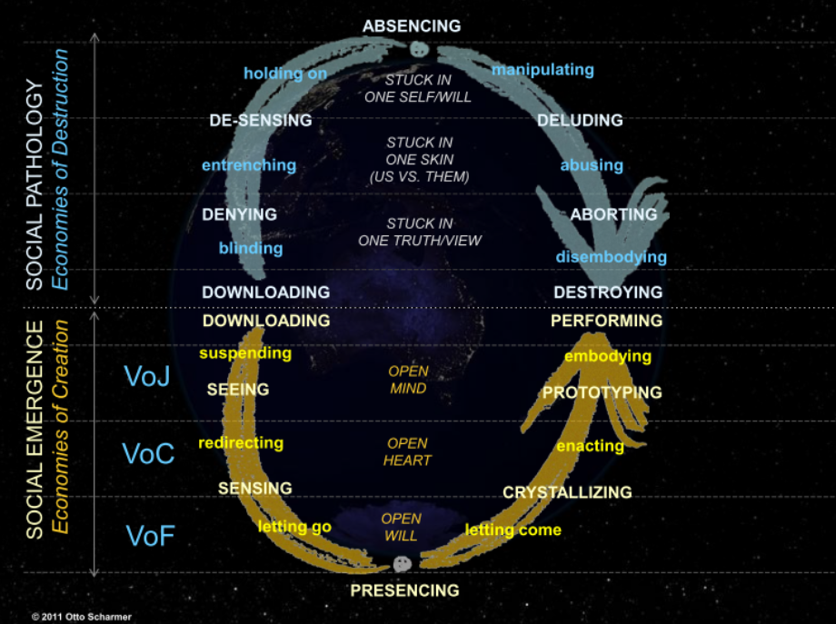
From… To…
9
Denying
Desensing
Absencing
Deluding
Aborting
Open mind
Open heart
Open will
Source: https://petersnijders.info/theorie-u-scharmer-2012/

Slide 27
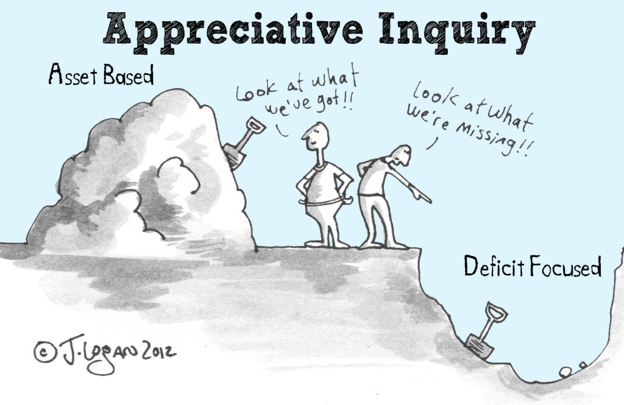
Appreciative Inquiry –
Positive Psychology
10
Appreciative
What do you want to see/do more often?
Look at what's already there and how it came to be.
Inquiry
Asking questions
Endure not knowing
Participating
Investigate together
No standard solutions
Source: https://www.bridgingspaces.nl/nieuws/waarderend-onderzoek-appreciative-inquiry/
Notes:
More information?
2000 Seligman & Csikszentmihalyi - Positive-Psychology - an introduction
https://positivepsychology.com/appreciative-inquiry/#appreciative-inquiry

Slide 28
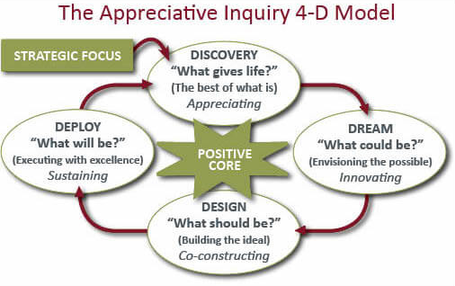
Process
10
Source: https://cvdl.ben.edu/blog/what-is-appreciative-inquiry/

Slide 29
Appreciative inquiry
10
The sustainable: what are we building on? What is already there and how did it come to be?
The new: What do we want more of? What are we capable of? What do we desire?
The transition: Which actions lead to change? What do we do?

Slide 30
Motivational Interviewing I
11
Motivational Interviewing is a collaborative communication style to evoke and reinforce motivation for change.
Notes:
More Information to read:
2002 DiClemente- Motivational_Interviewing_and_the_Stages_of_Change
Change language - 2012 Miller & Rollnick- Book Motivational interviewing

Slide 31
Motiviational Interviewing II
11
GOAL
Reduce ambivalence
Increase intrinsic motivation
Change behaviour
LEVEL OF WILLINGNESS
Varies by moment, person and situation
Is influenced by interaction
“Lack of motivation is not our client’s fault, it is a challenge to our skills” (Miller/Rollnick 1991)
Notes:
Ambivalence: Client has change language and retention language (advantages and disadvantages towards change).
This is a normal part of the change process

Slide 32
Four conditions for change
11
Dissatisfaction with the current situation
The new goal is sufficiently attractive
Positive experience of transition in the past
Sufficient support in the social environment

Slide 33
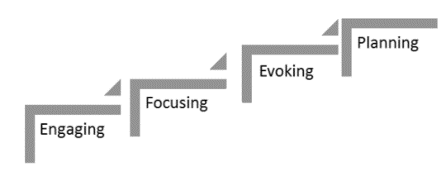
Phases
11
Phase 1: Engage → connect in a safe environment
Phase 2: Focus → clear goal setting. Setting a clear purpose is important! As a facilitator, you are NEUTRAL to the outcome
Phase 3: Evocation → specific to Motivational interviewing → eliciting change language
Phase 4: Planning → Personal and unique plan (clarify intention and
confidence by using a scale question)
Source: https://uncmotivationalinterviewing.wordpress.com/2017/02/01/motivational-interviewing-components-process-of-motivational-interviewing/

Slide 34
Phasing motivational interviewing
11
Making and keeping real contact
  Empathetic, actively involved, collaborative
Goal setting
  Acceptable and realistic.
  Positively articulate
  Exploring motivation/ restoring self-confidence
Compile an action plan
  Small and realistic
  Reinforce positive feelings
  Eliciting change language
Move
  Step by step
  Focused on motivation, readiness for action and self-confidence

Slide 35
11
DO’s and DONT’s
WHAT DOES AND DOES NOT BELONG TO MOTIVATIONAL INTERVIEWING?
DO:
Boost self-confidence
Compassion
Listen
Kindle
Respect autonomy
Collaborate
Accept things as they are
(endure discomfort)
DON’T:
Reject
Confront
Counter
Giving unsolicited advice
Labelling
Calling to account
The repair reflex

Slide 36
Create new beliefs
12
What would you like to believe instead?
  "Nothing has meaning except the meaning you give it yourself.“
Stop judging; it's not about right or wrong but about asking:
  "What helps me move forward?“
Think in possibilities
  "Whatever happens: I seek out the aspects that I can influence, within my capabilities, and that I can do something about. I have the choice."

Slide 37
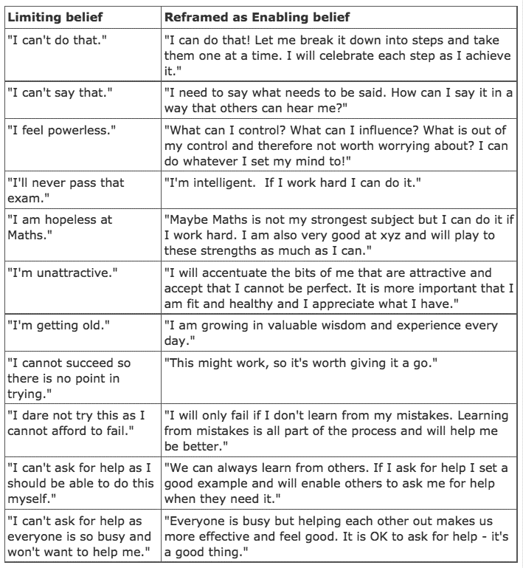
12
Reframing beliefs
Source: https://padfieldpartnership.com/how-your-mindset-can-enable-or-limit-you/

Slide 38
Reframing thoughts
12
Unhelpful thought (fixed mindset) | Helping thought (growth mindset)
I can't. | I can't do this yet.
I am bad at administration. | Keeping my administration in order requires extra effort.
Someone else can do this much better. | Someone else has done this much more often than I have. Maybe I can learn from her.
If I had a real talent for it, it would come naturally. | Even people with innate talent have to work hard for it.
I am not a good manager. | I try very hard to be the best I can be, and the fact that I make mistakes from time to time is part of it.
It's not worth it. | If you really want something, it is worth putting effort into.
It doesn't work out anyway. | I can learn from trying.
Everything goes wrong. This is never going to be anything. | Adversity is part of it. What can I learn from this? Who could help me?

Slide 39
Change language
12
Disadvantages of the current situation
  Costs and benefits
Benefits of changing
  What reasons are there to change?
  Risks of not changing
Optimism of change
  Scale questions: Motivation
    Rating for the current situation
    What is a good situation?
    How important?
Intention for different behaviour
  Scale questions: Confidence, belief in feasibility
    Rating for confidence
    Why not lower?
    How important?

Slide 40
Provoke change language
12
Examining pros and cons
Provoking optimism
Getting good intentions declared
Investigating extremes
Looking back or looking forward
Exploring goals and values
Reframe
Seeking positive exceptions

Slide 41
Characteristics
12
Elicit (Are there any points to improve, what would you like to achieve? Why is it so important right now?)
Examining pros and cons (what are you most worried about, how do you feel after ....?) (what are the benefits like, what do you find attractive about it?)
Eliciting optimism (imagine it has already succeeded; How did it succeed then?)
Have good intentions expressed (what could be adjustments, what other ways are there?)
Examining extremes (suppose nothing changes, what is the worst that could happen, and what are the best possible outcomes?)
Looking back or looking forward (have you looked at it differently in the past, how did you do it then, when would you care?)
Exploring goals and values (what do you find most important in life/work/relationships, what would you like to achieve through this?)
Reframing (you feel terrible that things turned out this way, but you had no choice, you have no experience, but this could be a first step to gaining experience)
Looking for positive exceptions (when did it work/not work once?)

Slide 42
Alert on change language
12
I would like that (desire=D)
I could do that (ability=A)
I do have a good reason for it though (reason=R)
I should do that (necessity=N)
I'm going to do it (commitment=C)
I am willing to ...(activation= A)
I have already taken a step (taking steps=T)
41

Slide 43
Strengthening change language
12
Give attention to ambivalence
Ears keen on change language
Respond using ORBS (open questions, reflect, confirm/compliment, summarise)
Then plan (SMART) actions (Specific, measurable, acceptable, realistic, time)

Slide 44
Learning objective:
“I want to learn to step out of my comfort zone more”
12
EXAMPLE
Event: Consideration of whether to give a presentation on my project
Thoughts (Not-helpful):
  What will they think of me when I do/don't do it?
  I don't dare because I am not a good speaker. I am often too brief and finish too quickly.
  If I offer it, I am sure someone else will know more about it.
  They are going to ask me questions I don't know the answer to.
Feelings: dispirited, sad, no energy and motivation
Behaviour: I avoid the things I’m afraid of in my job
Consequence: no presentation/ calling in sick/ feeling bad about profiling internship

Slide 45
Learning objective:
“I want to learn to step out of my comfort zone more”
12
EXAMPLE
Event: consideration of whether to give a presentation on my project
Thoughts (Helpful)
  I can then show that I thought of something myself, even though I find it scary to do
  I can also suggest preparing it together with my practice supervisor and possibly doing part of it together
  If I take control, I can also shape it more the way I want to
  ...
Feelings: drive to figure something out/ preparation to tackle content
Behaviour: making contact/ getting creative/ searching etc.
Consequence: the first step

Slide 46
Types of questions
12
REFLECTIVE QUESTIONS/INSIGHTFUL QUESTIONS
  focused on awareness of own share regarding the current situation
    Behaviour
    Skills and beliefs (What do I do myself? What do I want myself? What do I think myself that makes it work/not work?)
  Understanding own scenarios regarding the future situation
  Insight into action possibilities
ACTION-ORIENTED QUESTIONS
  Small concrete steps
  Asking for help and preparing for action
  Doing!!!
  Reflecting on learning effects so that next time there is a follow-up

